Slide 1

Data Modeling
Pertemuan 4
Zyad Rusdi

Slide 2
THE ENTITY-RELATIONSHIP DIAGRAM (ERD)
An entity-relationship diagram (ERD) is a picture showing the information that is created, stored, and used by a business system.
Entities lists similar kinds of information
Lines drawn between entities represent relationships among the data.
Special symbols communicate high-level business rules.

Slide 3
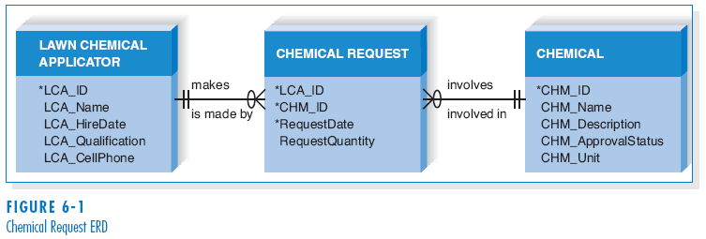
Reading an Entity Relationship Diagram

Slide 4
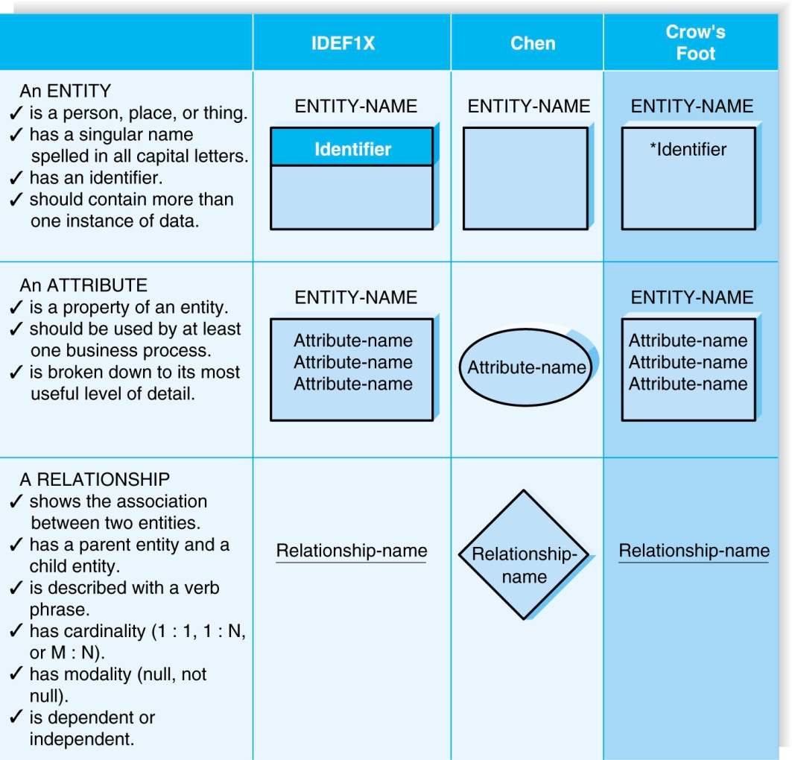
Elements of an Entity Relationship Diagram

Slide 5
Entity
The entity is the basic building block for a data model. It is a person, place, event, or thing about which data is collected.
Entities represent something for which there exist multiple instances, or occurrences.
- E.g., John Smith could be an instance of the customer entity.

Slide 6
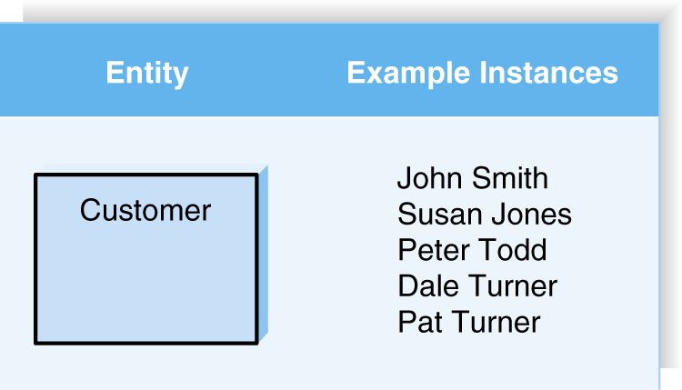
(cont’d)

Slide 7
Attributes
An attribute is some type of information that is captured about an entity.
Attributes are nouns that are listed with an entity.
One or more attributes can serve as the entity identifier - the attribute(s) that can uniquely identify one instance of an entity.
Concatenated identifier - several attributes are combined to uniquely identify an instance.

Slide 8
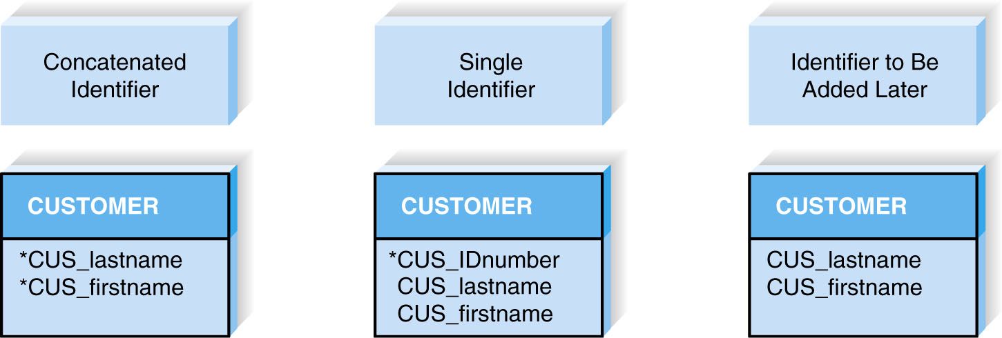
(cont’d)
Choices for Identifiers

Slide 9
Relationships
Relationships are associations between entities.
Every relationship has a parent entity and a child entity.
Relationships should be labeled with active verbs.

Slide 10
Cardinality
A relationship has cardinality which is the ratio of parent instances to child instances.
The 1:1 relationship means that one instance of the parent entity is associated with one instance of the child entity.
The 1:N relationship means that a single instance of a parent entity is associated with many instances of a child entity.
The M:N relationship means that many instances of a parent entity can relate to many instances of a child entity.

Slide 11
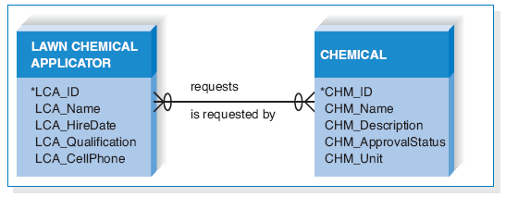
(cont’d)
Example of M:N Relationship

Slide 12
Modality
A relationship has modality of null or not null, which refers to whether or not an instance of a child entity can exist without a related instance in the parent entity.
Null means that an instance of a child entity can exist without a related instance in the parent entity.
Not Null means that an instance of a child entity can’t exist without a related instance in the parent entity.

Slide 13
The Data Dictionary and Metadata
A data dictionary contains the information about the entities, attributes, and relationships on the ERD, or metadata.
Metadata is data about data.
Metadata is stored in the data dictionary so it can be shared by developers and users throughout the SDLC.

Slide 14
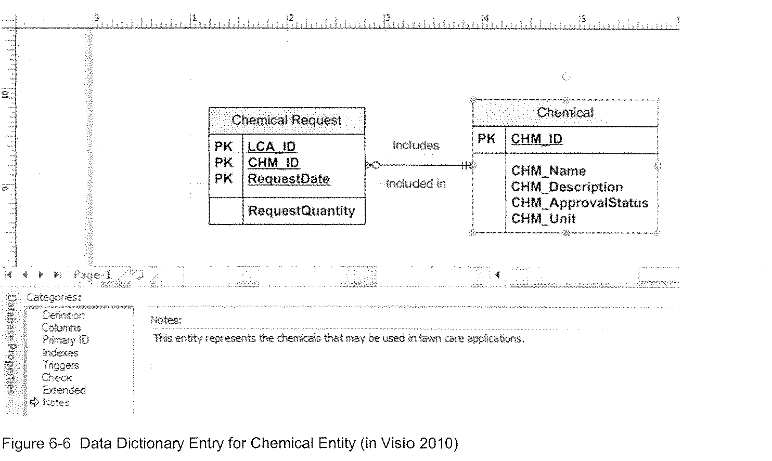
(cont’d)
Example of Data Dictionary Entry for Entity

Slide 15
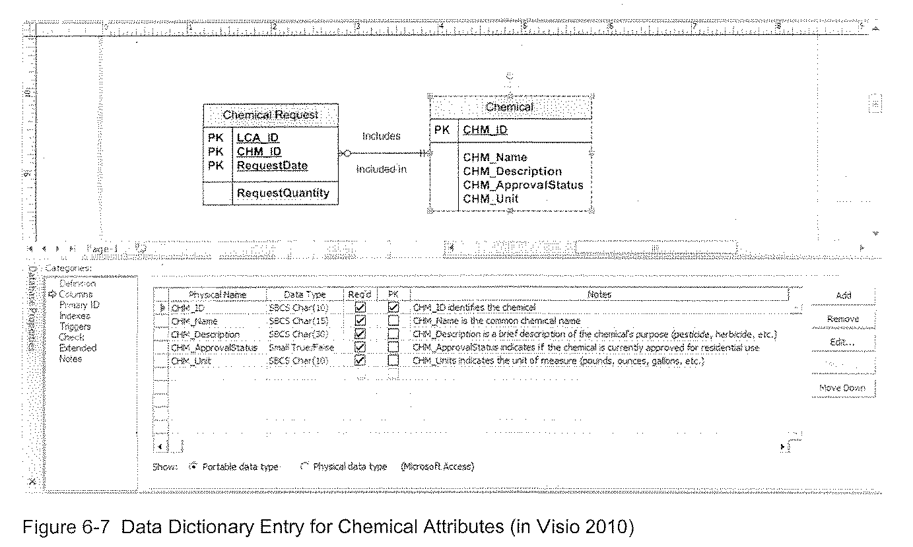
(cont’d)
Example of Data Dictionary Entry for Attributes

Slide 16
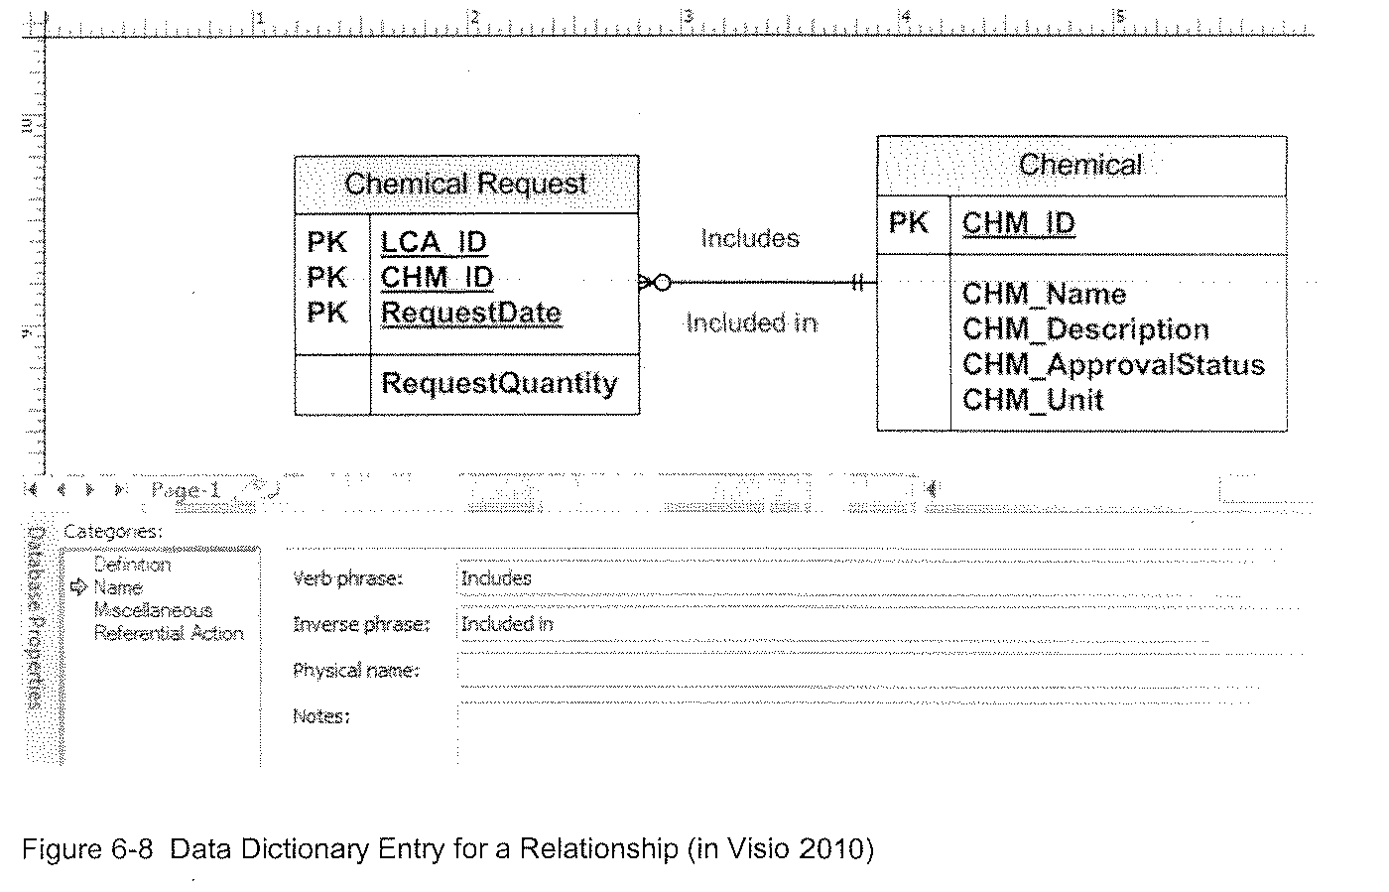
(cont’d)
Example of Data Dictionary of Entry for Relationship

Slide 17
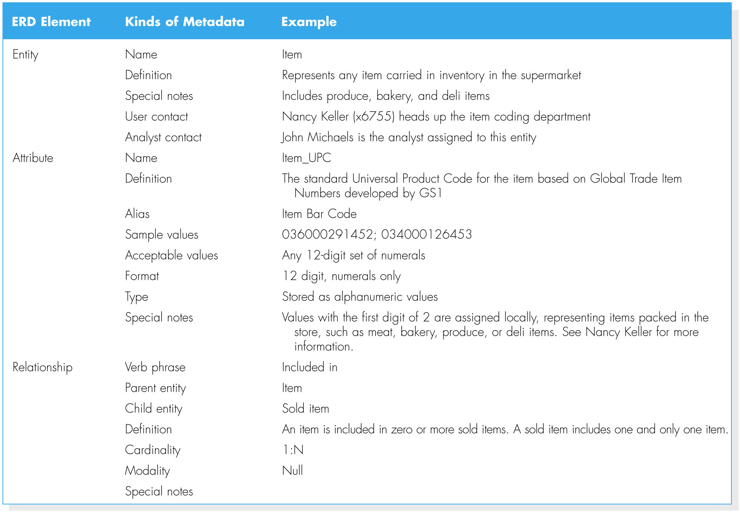
(cont’d)
Types of Metadata Captured by the Data Dictionary

Slide 18
CREATING AN ENTITY RELATIONSHIP DIAGRAM (ERD)
Drawing the ERD is an iterative process of trial and revision.
The basic steps in building an ERD:
1. Identify the entities;
2. add the appropriate attributes to each entity; and
3. draw relationships among entities.

Slide 19
Step 1: Identify the Entities
The entities should represent the major categories of information that you need to store in your system.
If you begin the data model using a use case, look at the major inputs and outputs of the use case.
If the process models are available, look at the data stores, external entities, and data flows.

Slide 20
Step 2: Add Attributes and Assign Identifiers
The information that describes each entity becomes its attributes.
Check in the CASE repository of the process model for details on data flows and data stores.
Check the data requirements of the requirements definition.
Use requirements elicitation techniques (e.g., interview and document analysis).
One or more of the attributes will become the entity’s identifier.

Slide 21
Step3: Identify Relationships
The last step in creating ERDs is to determine how the entities are related to each other.
Lines are drawn between the entities that have relationships.
Each relationship is labeled, and cardinality and modality are assigned.

Slide 22
Advanced Syntax
Three special types of entities:
Independent Entity
Can exist without the help of another entity.
The identifiers is created from the entity’s own attributes.
Attributes from other entities are not needed to uniquely identify instances of these entities.

Slide 23
(cont’d)
Dependent Entity
There are situations when a child entity does require attributes from the parent entity to uniquely identify an instance. In these cases, the child entity is called a dependent entity, and its identifier consists of at least one attributes from the parent entity.
(E.g., the Chemical Request entity in Figure 6.1).

Slide 24
(cont’d)
Intersection Entity
It exists in order to capture some information about the relationship between two other entities. Typically, intersection entities are added to a data model to store information about two entities sharing an M : N relationship.

Slide 25
(cont’d)
There are three steps involved in adding an intersection entity:
Step 1. Remove the M:N relationship line and insert a new entity (intersection entity) in between the two existing ones.
Step 2. Add two 1:N relationships to the model.
Step 3. Name the intersection entity.

Slide 26
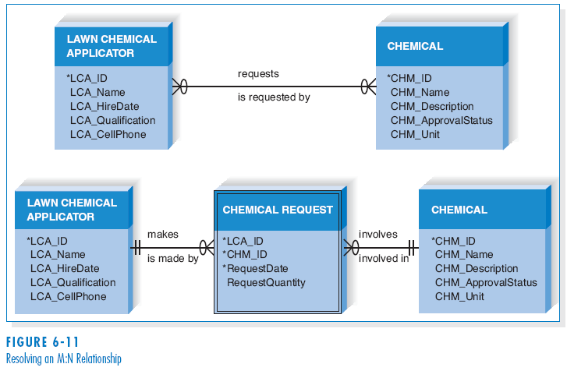
(cont’d)
Resolving an M:N Relationship

Slide 27
VALIDATING AN ERD
General design guidelines.
Normalization.
Check the ERD against the process models to make sure that both model balance each other.

Slide 28
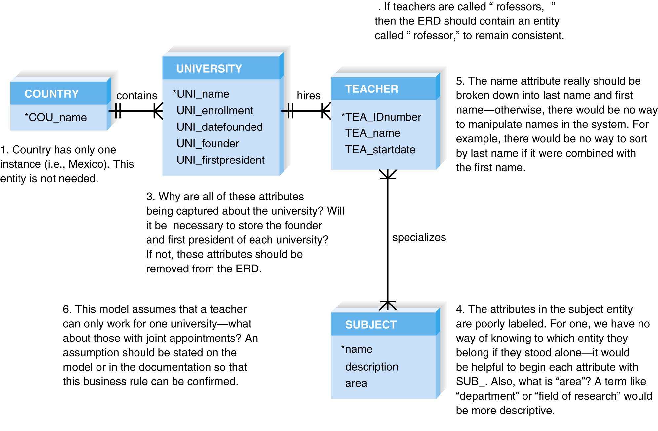
Design Guidelines

Slide 29
Normalization
Normalization is a technique that can help analysts validate the data models.
It is a process whereby a series of rules are applied to a logical data model to determine how well formed it is.

Slide 30
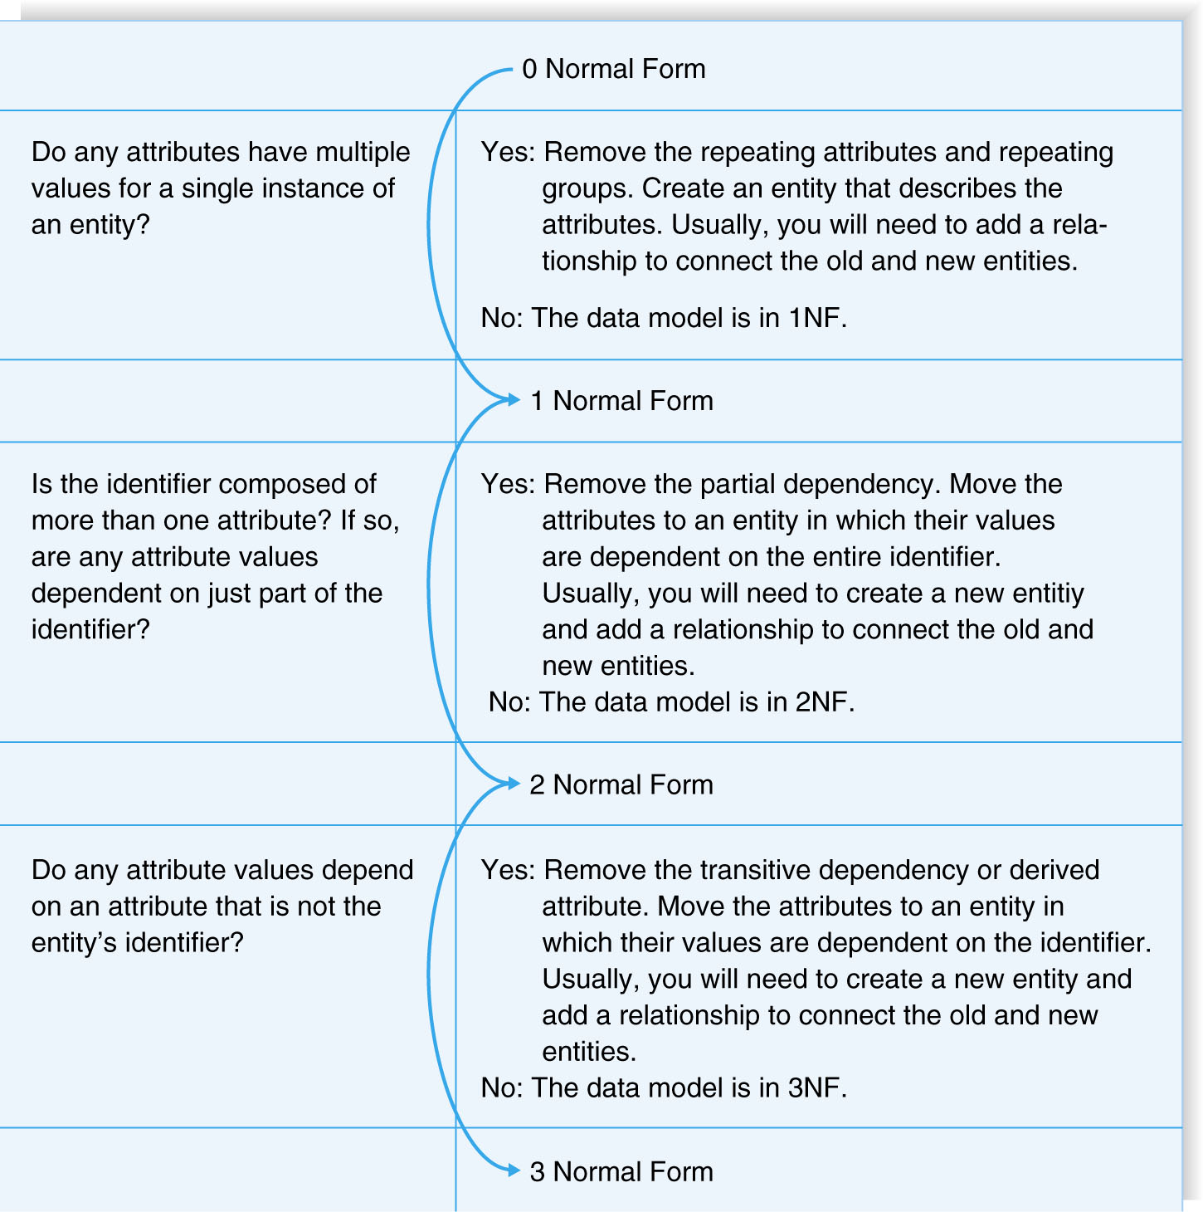
(cont’d)
Normalization Steps

Slide 31
Balancing ERDs with DFDs
The process models and data models are interrelated.
Although the process model focuses on the business processes, it contains two data components – the data and the data store.
These two data components of the DFDs need to balance with the ERDs.
The DFD data components need to correspond with the ERD’s data stores (i.e., entities) and the data elements that comprise the data flows (i.e., attributes) depicted on the data model.

Slide 32
(cont’d)
Many CASE tools provide features of identifying problems with balance between DFDs and ERDs; however, it is important to understand how to identify problems on your own.
Check your DFDs and ERDs to make sure all data components correspond between DFDs and ERDs.
A useful tools to clearly depict the interrelationship between process and data models is the CRUD matrix (create, read, update, delete matrix).

Slide 33
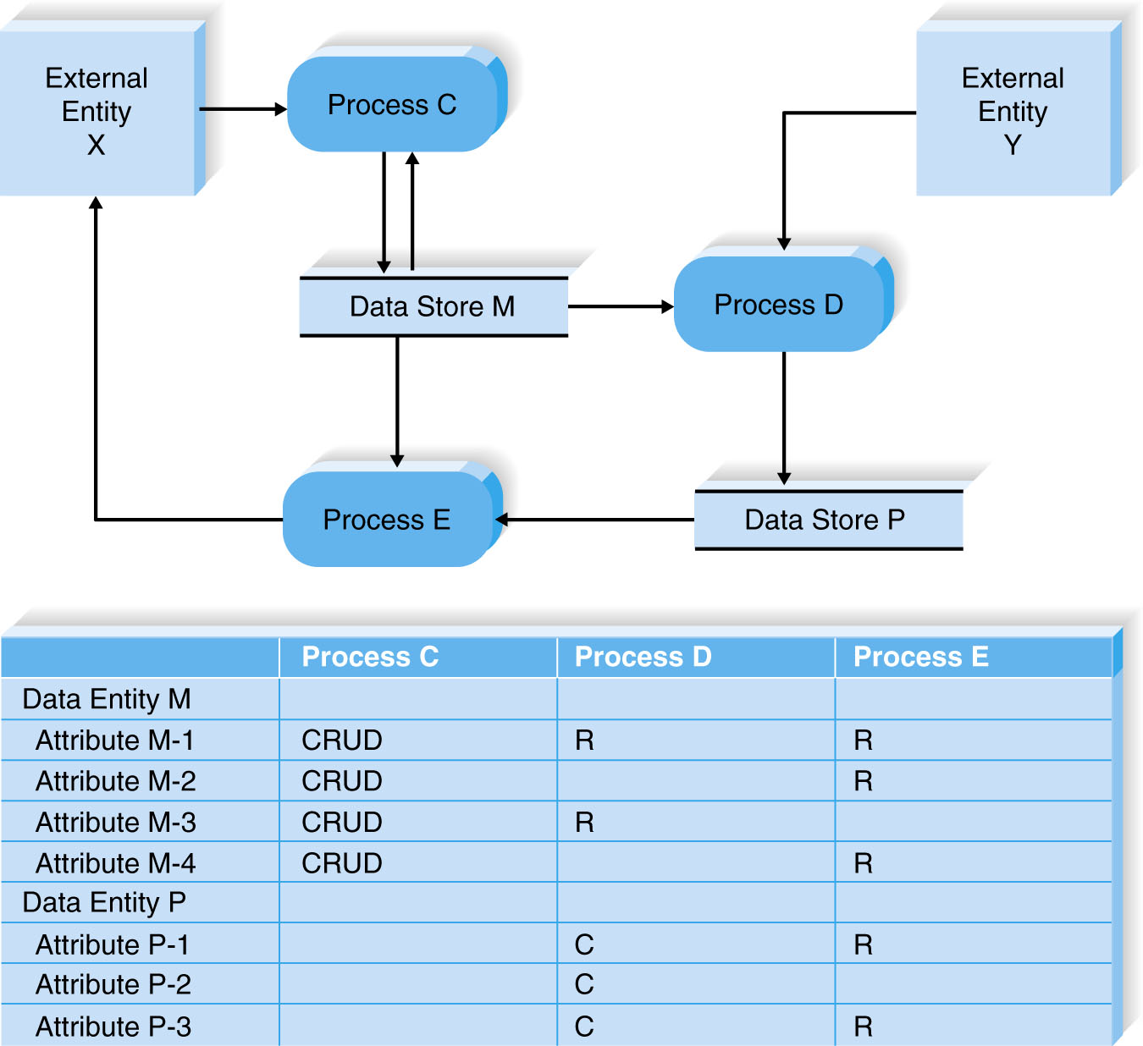
(cont’d)
A Portion of a DFD and the CRUD Matrix

Slide 34
SUMMARY
Basic Entity Relationship Diagram Syntax
- Entity describes people, places, or things.
- Attribute is some type of information about the entity.
- Relationship conveys the associations between entities.
Creating an ERD
- Identify the entities.
- Add the attributes to each entity.
- Draw relationships among entities.
Validating an ERD
- Normalization
- CRUD matrix

